Slide 1

The Impact of UI and UX Design on Web Application Quality: A Mixed Methods Study.
JH248828
Notes:
The title of my proposal is the impact of UI and UX design on web application quality: a mixed method study

Slide 2
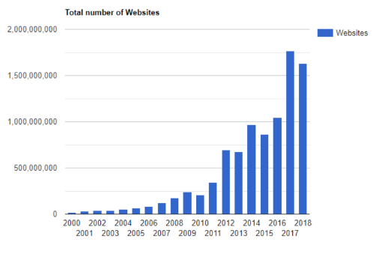
Background: The Proliferation of Websites and the Rise of Website Builders
The number of websites has increased exponentially with the launch of Web 3.0, leading to the creation of website builders for users to easily manage and alter their designs.
As of 2020, 43% of websites were using the website builder WordPress, an increase from 13% in 2011.
The target demographic for web builders is non-developers creating their first website.
The growing number of developers and non-developers makes understanding UX crucial for maximizing the potential of web applications.
The use of web builders can contribute to negative UX consequences, such as poor brand perception and decreased product value.
Notes:
The rapid expansion of the internet with the launch of Web 3.0 has led to a significant increase in the number of websites. To make it easier for users to manage and customize their website designs, website builders have been developed. These builders allow users to simply drag and drop pre-made components into place, without the need for coding knowledge in HTML or CSS.
In 2020, 43% of websites used the website builder WordPress, up from 13% in 2011. This rise in popularity is likely due to the convenience and accessibility of these builders for non-developers creating their first website as these users may not have the same level of knowledge and expertise as experienced web developers.
For these non-developers, user experience (UX) is crucial in maximizing the potential of web applications. UX involves using user-based metrics to evaluate whether a user interface (UI) design enables effective interaction and meets user requirements.
Website builders may limit the effectiveness and uniqueness of design by only offering a set of predetermined tools. Negative UX can impacts brand perception and decreases product value, while positive UX can help a website stand out through increased traffic or search engine optimization.

Slide 3
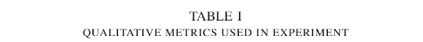
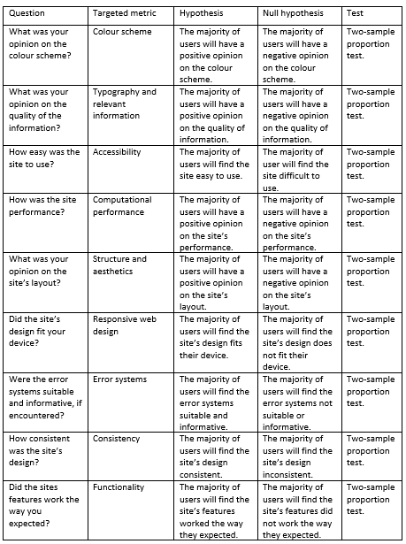
Research method
Literature review
Artefact A/B test
Test A, Ecommerce website with design alterations
Test B, similar site made with a website builder
Task
Selecting several products and completing sites life cycle
Tests core functionality
Questionnaire
Notes:
A literature review serves as the foundation for this study, using previous research to inform the design decisions for the artefact and the questions in the questionnaire.
The study consists of two parts an A/B test between two similar artefacts and a thematic analysis of results from a questionnaire given too two study groups.
The first study group will test artifact A, an ecommerce website with specific alterations to its design informed by the literature review. The second group will test artefact B a website of the same genre made with a website builder.
Each group will be tasked with selecting several products from different categories and adding them to the site's basket or cart.
Participants complete this task by reaching the final stage of the application's life cycle, either a checkout page or confirmation page.
Collecting several products gives users the opportunity to use all of the site's core functionality, such as search and filtering.
After completing the task, participants will fill out a qualitative questionnaire with the questions present in the figure provided in this slide.
Artefact A will also use a click heat map via Microsoft Clarity to determine which elements were clicked the most.

Slide 4
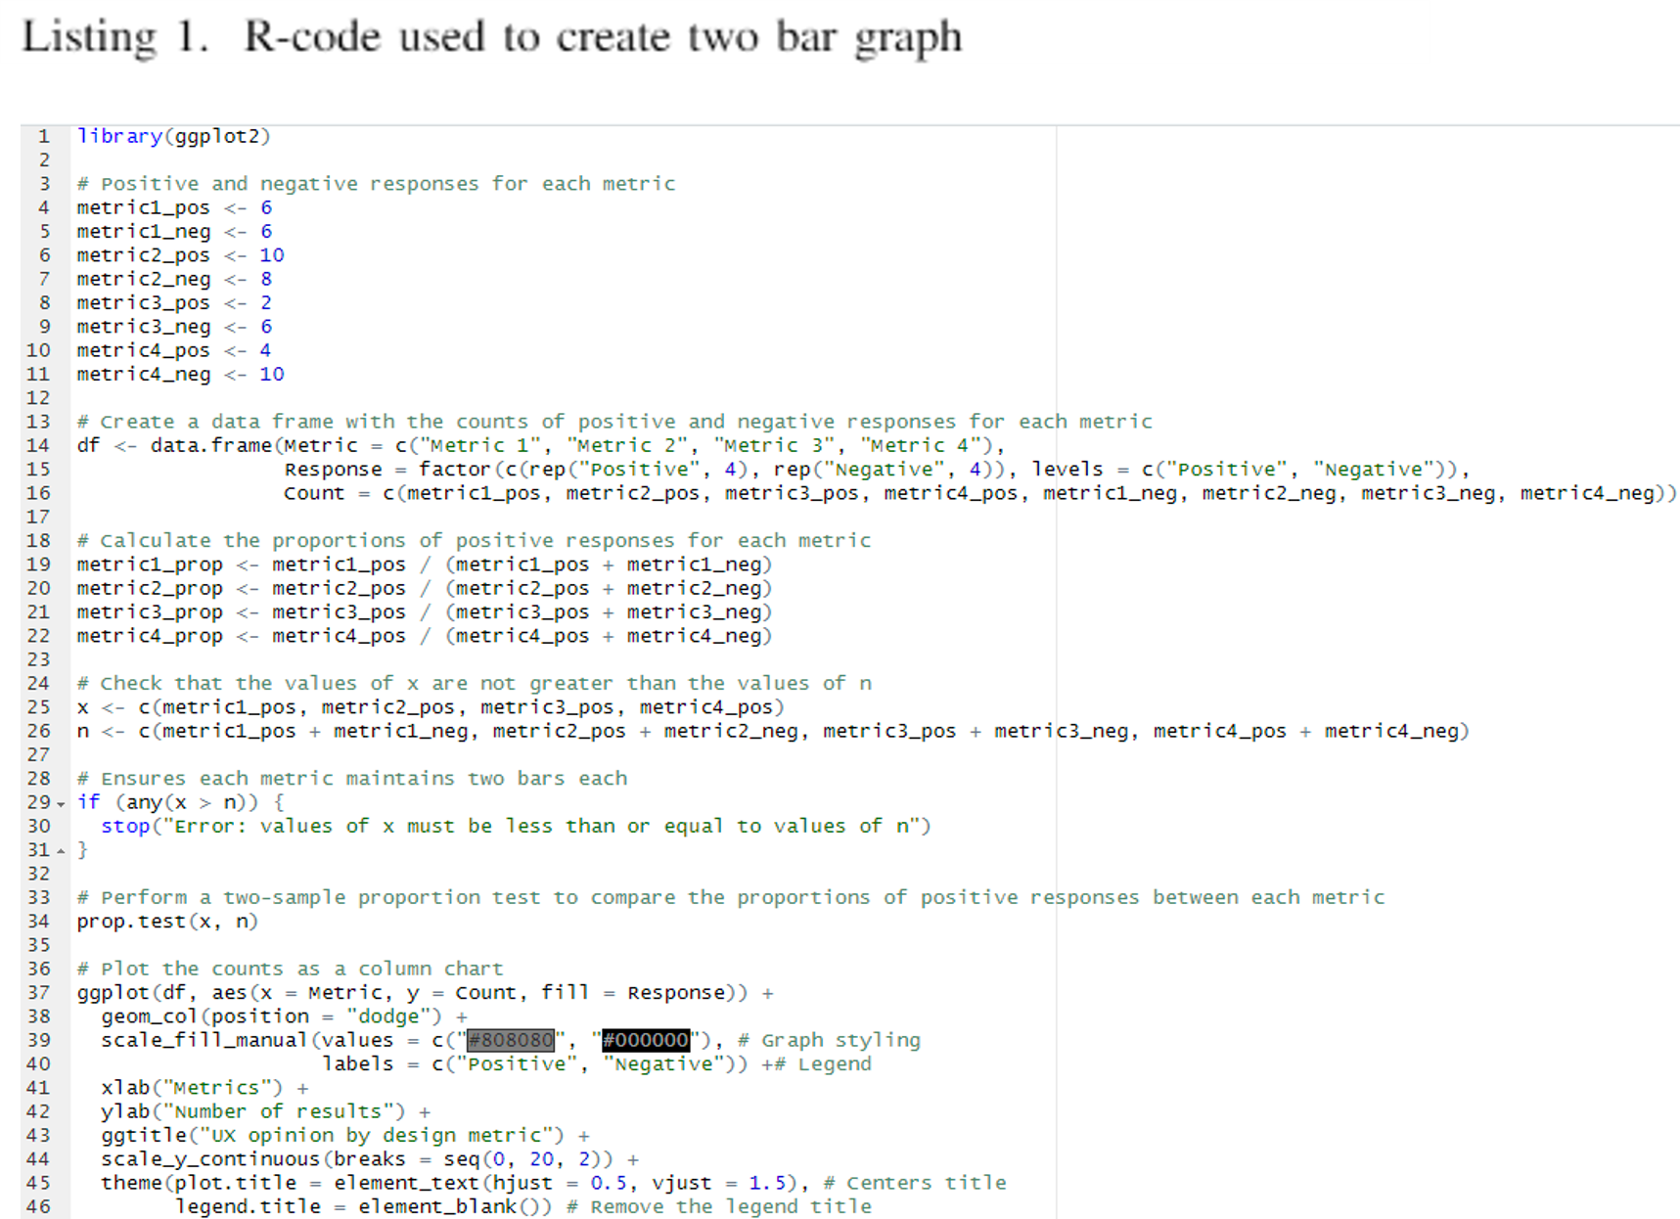
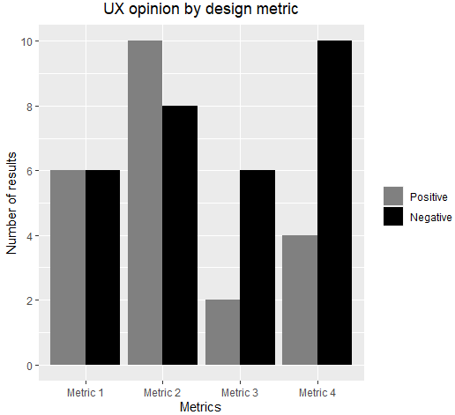
Data Collection - Method
Hypothesis
Null: Metric had no affect on users
Alternate: Users were impacted by metric
Two sample proportion test
Column chart
Artefact A
Artefact B
Z score comparison
Thematic analysis
Notes:
My hypothesis, as shown in the previous slide, generally follows the format: null hypothesis means the users were unaffected by the metric and the alternate being they were affected by the metric.
I will be using a two-sample proportion test to test the significance of each null hypothesis. This test will compare the number of positive results against the number of negative results using R's ‘prop.test’ function Results with a z-score greater than 0.5 will suggest more positive than negative results and thus reject the null hypothesis.
The positive and negative results will be plotted using the ‘ggplot’ library in a column chart with each metric having a positive and negative bar. The number of positive or negative results will be the dependent variable and the design metrics will be the independent variables.
For the A/B artefacts, each will have its own graph. The z-scores of each metric in each artefact will then form their own column chart, with the first bar representing the z-score of artefact A and the second bar representing artefact B. The x-axis will stay the same, but the y-axis will be the z-score instead of the number of results. The artefact with the higher z-score under the same metric will have the design that better benefits that metric.
Based on the results of the final column chart's z-score comparison and the qualitative answers given in the questionnaire, a thematic analysis can be used to determine which design elements caused the z-score’s outcome and, by extension, why one artifact performed better under each metric. This is done by grouping determinable factors into themes and then organizing those themes into design decisions that affect the metric.

Slide 5
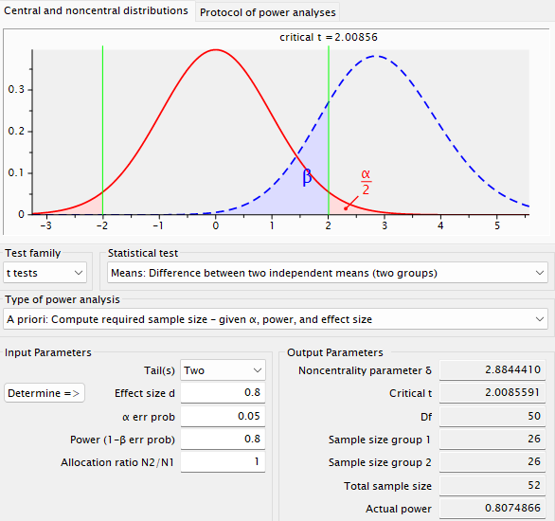
Data Collection - Sampling
Large effect
Qualitative answers
Opened ended task
Same metrics across both tests
Larger sample limits experiment quality
Standard error probability
Notes:
For the sample size of the A/B test, I will use 26 for each group, totalling 52 participants. This decision was made due to the use of qualitative answers instead of quantitative data, as well as the ability for users to approach the experimental task in different ways, resulting in longer and more varied responses.
Additionally, using the same questions for both artifacts will provide enough varied responses to allow for patterns to be drawn and assumptions to be made in the thematic analysis, enabling conclusions to be drawn about either an individual artefact or both.
A larger sample size only serves to impact the experiments running time, as qualitative data requires far more time investment from participants compared to quantitative data
I have maintained standard error probabilities as they are unlikely to be affected by the requirements or goals of the experiment.

Slide 6
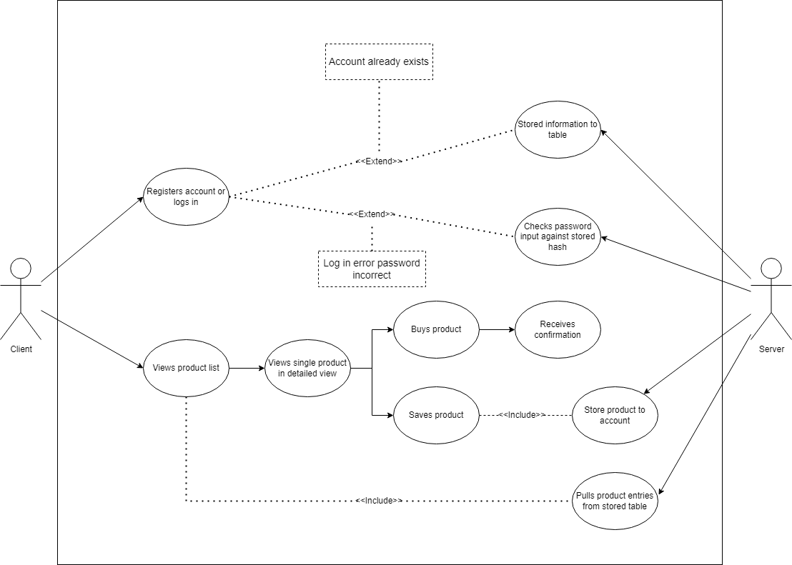
Artefact - Overview
Artefact A
Online electronics ecommerce website
Artefact B
Similar genre (ecommerce)
Made with a website builder
Features
Login and registering
Searching and filtering
Cart system
Checkout page
Cloud hosted
Heroku
Clear DB
Stack
React
Node JS
Express
SQL
Notes:
Artefact A is an ecommerce website specifically for electronic goods, and it is the artifact demonstrated in this study. Artefact B is a similar website created with a website builder, and it is strictly used for comparison within the scope of this study.
Both websites will have login and registration, search and filtering, and cart systems, as well as a checkout page.
Both websites are cloud-hosted, with artefact A using Heroku for the front-end and back-end and Clear DB for the database. Artefact B will use the website builder's built-in hosting service.
The technology stack for artefact A includes React for the front-end and Node, Express, and SQL for the back-end. React was chosen due to its popularity and functional approach, while Node and Express were selected for their integration with other technologies like SQL. SQL was chosen because of the logical and structured form of data required. Artefact B will use the technologies most commonly used by the given content management system, such as PHP, HTML, and SQL

Slide 7
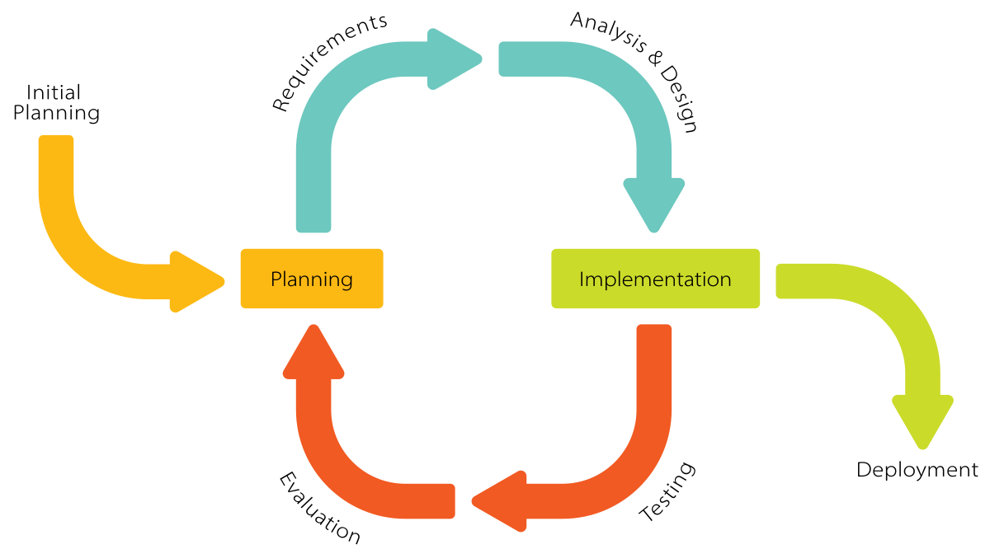
Artefact – Life cycle and Testing
Life cycle
Incremental development cycle
Testing
Unit testing
Integration testing
Acceptance testing
Usability testing
Reference: https://commons.wikimedia.org/wiki/File:Iterative_Process_Diagram.svg
Notes:
The artefact's development cycle is incremental, as it allows the artefact to be divided into sections that can be improved upon iteratively. This development cycle was chosen over an agile approach because, although it follows many of the same practices, it is more suited to a situation where the requirements of the artifact are unlikely to change. The incremental approach also allows for individual features to receive feedback throughout the development process
The testing areas for this artifact include unit testing, integration testing, acceptance testing, and usability testing
Unit testing will manually test individual features by interacting with them, including the cart, search, checkout, and product systems. Automated systems can also be used to help with this process
Integration testing will also manually test the functionality of site-wide features, such as testing the search system with product pages or the cart displaying on the checkout page
Acceptance and usability testing are the most significant, given their links to user experience (UX)
Acceptance testing can be performed manually or through heuristic evaluation to verify that the site meets user requirements and expectations
Usability testing uses the same methods as acceptance testing and verifies accessibility and responsive web design practices
If the scope allows it, performance and security testing can also be employed

Slide 8

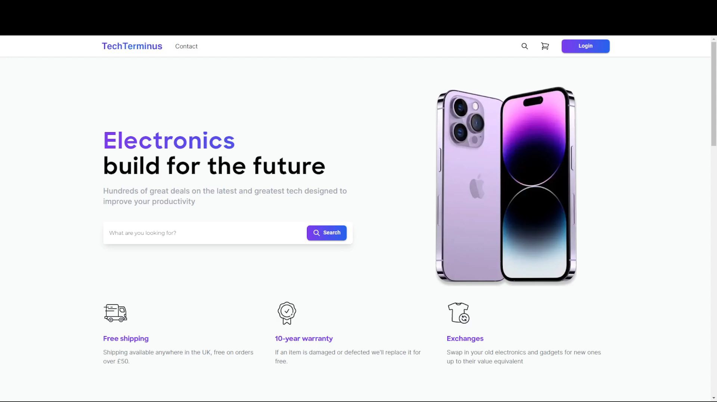
Artefact demonstration
Notes:
This is the demo for artefact A. As mentioned, artefact B is just for comparison
Artefact A features specific design alterations informed by the literature review, including a colour theory-oriented colour palette with purple and blue used to connote creativity and trustworthiness, key factors that target audiences are likely to look for. Animation and colour gradients have been used to increase engagement, and there is a large call to action in the hero section
(PLAY VIDEO)
In the hero section, the search bar serves as the call to action. Scrolling down, you can see two large cards with background animations, and there is an example of some of the products featured on the site. Notice that the product images are in or out of scene; this is to test whether adding a background scene affects engagement
There are typical login and registration systems, both of which use password hashing and input validation, such as requiring an email to include an @ symbol. Users are stored in the database
I will use an account that has already been registered in the database
Once you log in, a session is created, and the session user is placed in the header
You can now add products to the cart either from the latest products found on the index page or by using the hero or header search bars
The search bar filters products from the database's products table based on the search query
The results page features standard filter systems, such as sorting A to Z, the number of results, brand name, or price brackets
Clicking on a product brings up a more detailed page, from which it can be added to the cart
On the cart page, products can have their quantity updated or be removed from the cart
This page also features a checkout form, but it is not linked to the database and only redirects to a confirmation page once input validation has been passed
From this page, you can then fill out the form to reach the confirmation page or log out
The website is fully responsive, and the link is provided in the handout if you wish to view it further

Slide 9
Ethics and data storage
General Data Protection Regulation (GDPR)
Questionnaire guidelines
Anonymized names
No use of registering systems
No use of payment systems
Exported to CSV
Click map data
Notes:
The A and B tests require active participants, which means that the study will have to adhere to the General Data Protection Regulation (GDPR)
To ensure that the questionnaire for each study group contains a disclaimer informing participants that their personal information will be anonymized, participants will be referred to as "Participant 1," "Participant 2," etc. for either the A or B test
Both artefacts contain login and registration systems, and artifact B may also include a payment system. Participants will be instructed to complete their tasks without using these systems
Artefact A will automatically log users into a premade admin account and clear its users table from the database after the study. If they register with artifact B, their data will not be included in this study
The study's data will be collected through an online form sent via a secure link and exported to a CSV file, which will be stored on a USB in a secure location or uploaded to a secure location like Falmouth's OneDrive
The click map for artefact A will not require any user data and will only produce an image of the most common click locations

